Slide 1
Al-Driven Framework for Optimized Management of Local Body and MP Funds
The Team
Group no.16
Project Guide

Slide 2
Contents
Background
The Problem statement
Literature Survey
Proposed Solution
Implementation
Performance Comparison
Result
Future Scope
Relevance
Conclusion
References

Slide 3

Background
Challenges in Local Body & MP Fund Management
Inefficient Fund Allocation → Misaligned priorities, lack of data-driven strategy.
Poor Project Prioritization → No systematic approach based on public demand & feasibility.
Delays & Cost Overruns → Ineffective monitoring, bureaucratic inefficiencies.
Fraud & Anomalies → Weak financial oversight, lack of transparency.
Limited Public Engagement → Minimal citizen involvement, reduced accountability.
Notes:
Concerning

Slide 4
The Problem Statement
To analyze Local Body and MP fund management, addressing inefficiencies, project delays, fraud risks, and lack of public engagement through a data-driven framework.

Slide 5
Literature Survey
Using natural language processing to support peer-feedback in the age of artificial intelligence: A cross-disciplinary framework and a research agenda
https://doi.org/10.1111/bjet.13336
Advantages:
Structured NLP Framework
Peer-Feedback Process Model –
NLP-Based Adaptive Support –
Terminological and Procedural Scheme –
Cross-Disciplinary Approach –
Disadvantages:
Education-Focused Framework
Lack of Governance-Specific NLP Models
Limited Real-World Implementation
No Integration with Financial Optimization
Potential Scalability Issues
Notes:
Functional resonance imaging (fMRI)
It measures brain activity. MRI measures brain structure.

Slide 6
Literature Survey
Artificial Intelligence in Government: Taking Stock and Moving Forward
https://doi.org/10.1177/08944393211034087
Advantages
Global Policy Insights
Governance of AI
Trustworthy AI
Impact Assessment Methodologies
Data Governance
Disadvantages
Broad Focus on AI in Government
Limited Technical Implementation
Lack of NLP-Specific Insights
No Real-Time Monitoring Discussion
Ethical Considerations Without Implementation
Notes:
Functional resonance imaging (fMRI)
It measures brain activity. MRI measures brain structure.

Slide 7
Literature Survey
Where are researchers with this?
[1] P. Goel and A. Ganatra, "A Survey on Chatbot: Futuristic Conversational Agent for User Interaction," 2021 3rd International Conference on Signal Processing and Communication (ICPSC), 2021, pp. 736-740, doi: 10.1109/ICSPC51351.2021.9451763.
Advantages:
Easy to use
Offers good performance
Disadvantages:
Mishearing
Connection drops
High data use
Privacy issues
Notes:
Functional resonance imaging (fMRI)
It measures brain activity. MRI measures brain structure.

Slide 8
Literature Survey continuation
Where are researchers with this?
[2] M. H. Saibaba, S. F. Waris, S. H. Raju, V. Sarma, V. C. Jadala and C. Prasad, "Intelligent Voice Assistant by Using OpenCV Approach," 2021 Second International Conference on Electronics and Sustainable Communication Systems (ICESC), 2021, pp. 1586-1593, doi: 10.1109/ICESC51422.2021.9532956.
Advantages:
Easy to use
Cost effective
Disadvantages:
Listening Problems
Reliance on a constant Web connection
Notes:
Functional resonance imaging (fMRI)
It measures brain activity. MRI measures brain structure.

Slide 9
Proposed Solution
1. Fund Allocation OptimizationProblem: Ensuring equitable and need-based allocation of funds.AI/ML Solution:Use predictive analytics to identify areas with the highest need based on socio-economic indicators (e.g., poverty levels, literacy rates, healthcare access).Employ clustering algorithms to group regions by development priority.Use optimization models to suggest fund allocations that maximize impact.
2. Project PrioritizationProblem: Identifying projects that deliver the most benefit.AI/ML Solution:Use natural language processing (NLP) to analyze community feedback, survey responses, and project proposals to gauge public demand.Implement multi-criteria decision-making models to evaluate project feasibility, cost-effectiveness, and expected impact.
3. Fraud Detection and ComplianceProblem: Misuse or diversion of funds.AI/ML Solution:Use anomaly detection algorithms to identify irregularities in fund disbursement or expenditure patterns.Apply image recognition to validate the completion of physical infrastructure projects.Use blockchain technology for transparent and tamper-proof transaction records.
4. Monitoring and Progress TrackingProblem: Ensuring projects are completed on time and within budget.AI/ML Solution:Use IoT-enabled devices for real-time tracking of construction and development projects.Analyze satellite imagery with computer vision to monitor large-scale infrastructure projects.Build dashboard systems using ML to visualize project status and fl
Notes:
Concerning

Slide 10
Proposed Solution Continuation
Main Functionalities
5. Public Engagement and FeedbackProblem: Lack of community participation in decision-making.AI/ML Solution:Use chatbots powered by NLP to collect feedback from citizens about local projects.Analyze social media sentiment using AI to understand public opinion about ongoing initiatives.Deploy recommender systems to suggest projects based on citizen preferences.
6. Impact AssessmentProblem: Measuring the effectiveness of completed projects.AI/ML Solution:Use machine learning models to analyze pre- and post-implementation data (e.g., literacy rates, health outcomes, employment levels) to evaluate project success.Use predictive models to forecast long-term impacts of completed projects.
7. Budget Planning and Resource ForecastingProblem: Ensuring optimal use of funds in future planning.AI/ML Solution:Use time-series forecasting models to predict budget requirements based on historical spending patterns.Optimize resource allocation using dynamic programming models.
8. Transparency and ReportingProblem: Ensuring accountability in fund usage.AI/ML Solution:Implement automated report generation systems to provide regular updates to stakeholders.Use AI dashboards to create interactive visualizations for public scrutiny.

Slide 11
Implementation
Basic workflow
Taking the input as speech patterns through microphone.
Audio data recognition and conversion into text.
Comparing the input with predefined commands.
Giving the desired output.
Notes:
Concerning

Slide 12
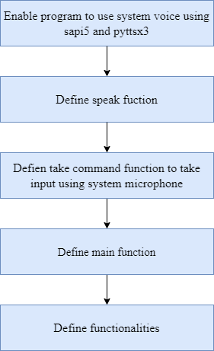
Implementation continuation
Methodology
Notes:
Concerning

Slide 13
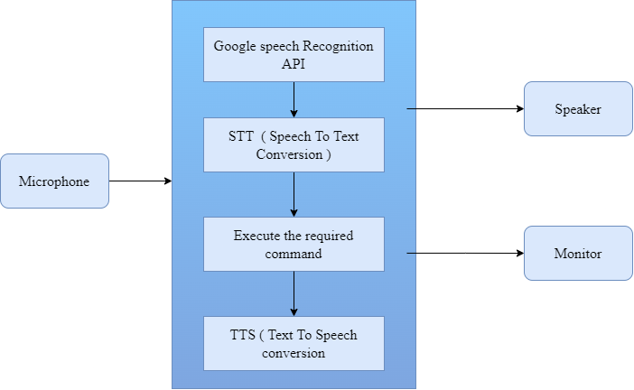
Implementation continuation
Processing block of STT to TTS
Notes:
Concerning

Slide 14
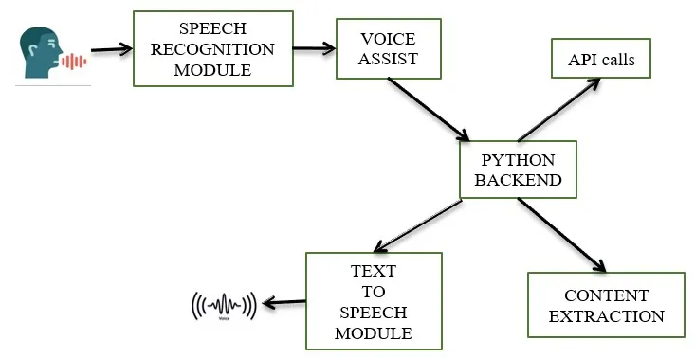
Implementation continuation
Architecture
Notes:
Concerning

Slide 15
Implementation continuation
Frontend development
For user login
For user input & starting data capture.
Platfrom used : Qt Designer
A GUI builder tool.
simple drag and drop interface
No need to write the code.
Not an IDE.
No facility to debug and build the application.

Slide 16
Implementation continuation
Backend development
Language used : Python
General-purpose programming language.
Used in machine learning, web development, desktop applications
Simple and easy-to-use syntax
IDE used : PyCharm
Used to write code and develop applications.
Supports Python programming and web development using Django.

Slide 17
Implementation continuation
Backend development
Database support: SQLite
Software library
Self-contained
Serverless
Zero-configuration
Transactional SQL database engine

Slide 18
Implementation continuation
Packages and modules required:
Speech Recognition:- understand whatever the humans speak and convert it
pyttsx3 :- Text to speech conversion library
Wikipedia :- Extracts data’s required from Wikipedia
datetime :- Used to show the date and time.

Slide 19
Implementation continuation
Packages and modules required:
time :- Helps to display time
Web browser :- It extracts data from the web to perform Web Search.
request :- Used to send all types of HTTP request
wolfram alpha :- API which can compute expert-level answers using Wolfram’s algorithms, knowledge base and AI technology.

Slide 20
Implementation continuation
Packages and modules required:
PyQt5 :- GUI widgets toolkit and Python interface for Qt .
SQLite3 :- Integrates the SQLite database with Python
sys :- Manipulates Python runtime environment.
smtplib :- Sends mail

Slide 21
Implementation continuation
Packages and modules required:
OS :- provides functions for interacting with the operating system.
PyAutoGUI :- can automate your GUI and programmatically control your keyboard and mouse.
win32clipboard :- A module which supports the Windows Clipboard API.
Selenium :- provide a convenient API to access Selenium Web Driver like Firefox, Chrome, etc.

Slide 22
Implementation continuation
Libraries Imported :
import speech_recognition as sr
import pyttsx3
import wikipedia
import datetime
import webbrowser
import time
import wolframalpha
import requests
import random

Slide 23
Performance Comparison
Criteria | Manual work | Voice assistant
Effort | Needs more effort to do tasks | Needs less effort,eyes free,hands free
Speed | Low | High
Time consumption | High | Low
Response | Slow | Fast

Slide 24
Result
Implemented a smart voice assistant for employees that could help them with simple tasks to improve their efficiency, productivity,minimizing errors ,and freeing up employee bandwidth for more important tasks
Note: include screenshots as next page
Also provide more comparison results

Slide 25
Future Scope
How can this be improved?
Additional functionalities for more specific tasks.
Customization
Development of voice assistant that can accept native languages also.

Slide 26
Relevance
Why is this important?
Enable a highly engaging user experience
Frustration free
Offer 24/7 support, without the costs
Builds your brand
Understand what user really wants

Slide 27
Conclusion
What did we infer from this?
This Voice enabled personal assistant, in today's life style will be more effective in case of saving time and helpful to differently abled people, compared to that of previous days.
Through this voice assistant, we have automated various services using a single voice command.
The project is built using open source software modules with PyCharm community backing which can accommodate any updates shortly.

Slide 28
References
Related research works.
[1] P. Goel and A. Ganatra, "A Survey on Chatbot: Futuristic Conversational Agent for User Interaction," 2021 3rd International Conference on Signal Processing and Communication (ICPSC), 2021, pp. 736-740, doi: 10.1109/ICSPC51351.2021.9451763.
[2] M. H. Saibaba, S. F. Waris, S. H. Raju, V. Sarma, V. C. Jadala and C. Prasad, "Intelligent Voice Assistant by Using OpenCV Approach," 2021 Second International Conference on Electronics and Sustainable Communication Systems (ICESC), 2021, pp. 1586-1593, doi: 10.1109/ICESC51422.2021.9532956.
[3] www.pythonprogramming.net
[4] https://www.tutorialspoint.com/python/index.htm
[5] www.youtube.com – How to create a voice assistant using Python

Slide 29
Thank You

